Slide 1
Lifecycle of Data Scientist (or Analyst)
Muhammad Fariduddin Adham
Data Analyst
26 August 2018

Slide 2
Lifecycle of Data Scientist
Business Understanding
Deployment
Data Understanding & Processing
Modeling

Slide 3
First Step: Business Understanding
Business Understanding

Slide 4
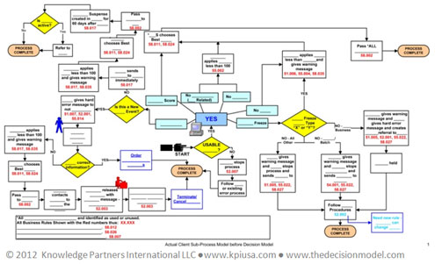

First Step: Business Understanding
Find out the business process
Find out the Business Process

Slide 5

First Step: Business Understanding
Define the Problem
I want to optimize z
Define the Problem

Slide 6
First Step: Business Understanding
Define the parameter to solve the problem
Sum(x)
Search Window
E[x]
DAU & MAU
Define the Parameter to Solve the Problem

Slide 7
First Step: Business Understanding
Define the parameter to solve the problem
Let’s take an example when we are trying to do optimization.
General formula for linear optimization:
z=a₁x₁+a₂x₂+.....+a_{n}x_{n}
With z as the value that we want to optimize, x as the variable that affect z, and a as the coefficient of x.
Obviously we need to find out what the x are we need to consider every x in the business process.
This is why we need to understand the business process first before asking the problem.

Slide 8
First Step: Business Understanding
Who are you working with?
Product Manager
Marketing Manager
Data Lead
Minimum level of understanding
Data Analyst: Mastery
Data Scientist: Mastery

Slide 9
Second Step: Data Understanding & Processing
Business Understanding
Data Understanding & Processing

Slide 10

Second Step: Data Understanding & Processing
Ingest the Data
Ingest the data

Slide 11
Second Step: Data Understanding & Processing
Ingest the Data
Create the Requirement based on the variable that is needed to solve the problem.
Design the Data that will be ingested from database.
If the data team has been properly established, usually there is a Data Engineer that will execute this.

Slide 12

Second Step: Data Understanding & Processing
Cleanse the Data
Cleanse the Data

Slide 13
Second Step: Data Understanding & Processing
Cleanse the Data
Usually there are some discrepancy or perhaps missing value in the data.
To cleanse those unwanted values, there is a method called Extract Transform Load or known as ETL.
Data Analyst / Scientist will create the design / requirement for the ETL.
If the data team has been properly established, usually there is a Data Engineer that will execute this.

Slide 14

Second Step: Data Understanding & Processing
Mine and Explore the Data
Mine and Explore the data

Slide 15
Second Step: Data Understanding & Processing
Mine and Explore the Data
This is the fun part for Data Analyst.
Analyze the behavior of the data.
Check for trend and seasonality in the data.
Familiarize with the behavior of the data.
Check for out of ordinary situation in the data.

Slide 16
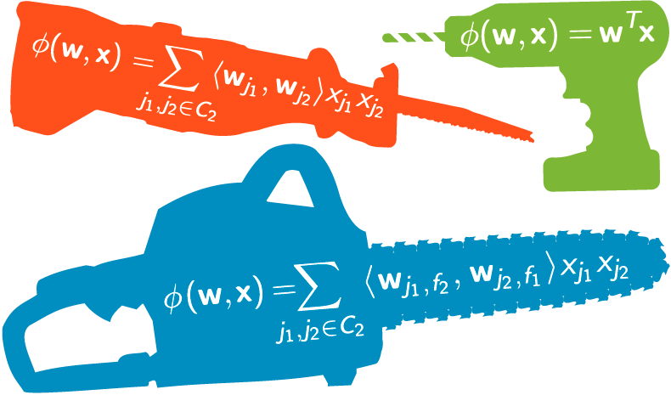
Second Step: Data Understanding & Processing
Feature Engineering
Feature Engineering

Slide 17
Second Step: Data Understanding & Processing
Feature Engineering
There are several data that needs to be properly transformed.
For example: when we want to analyze the behaviour of a customer. When we designed the data warehouse we only know when they booked the ticket as well as knowing when they are searching the ticket. This can easily combined to be a new variable:
Booking Window= Booking Date - Search Date
This can help keeping down the effect of seasonality as well as trends in some cases.
This is one of the simplest example as there are lots and lots of transformation that can be done.

Slide 18
Second Step: Data Understanding & Processing
Who are you working with?
Product Engineer
Data Engineer
Data Analyst (for Data Scientist)
Minimum level of understanding
Data Analyst: Mastery
Data Scientist: Basic

Slide 19
Third Step: Modeling
Business Understanding
Data Understanding & Processing
Modeling

Slide 20

Third Step: Modeling
Formulate the Model
Formulate the Model

Slide 21
Third Step: Modeling
Formulate the Model
This is where mathematics and statistics come in. Also this step is the hardest and the most time-consuming.
After choosing the variables and transforming the variable into their appropriate form, find the model that is similar with the problem we are facing.
There is not a single right answer. Don’t get excited over a model that fits the problem. Find other model that may look close so that they may be compared or even combine them.
Don’t panic when you didn’t find any model that close with the problem. There is always an option of creating your own model.
Notes:
Take an example of clustering with lots of model such as hierarchical clustering, k means clustering.

Slide 22
Third Step: Modeling
Formulate the Model
Let’s take an example when we are trying to do optimization.
General formula for linear optimization:
z=a₁x₁+a₂x₂+.....+a_{n}x_{n}
With z as the value that we want to optimize, x as the variable that affect z, and a as the coefficient of x.
Now that we know all the possible x, we need to find out the value of a

Slide 23
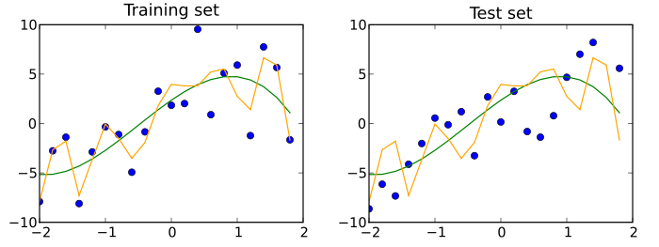
Third Step: Modeling
Model Training
Model Training

Slide 24
Third Step: Modeling
Model Training
This is where computational science comes in.
When the model has a very small error or fits perfectly with the data, there is a chance of overfitting happened. Ask for feedback with your lead or fellow data scientists.
There are certain conditions that made training or even testing model virtually impossible to be done. For this exceptional condition, formulating the model is more than enough.

Slide 25
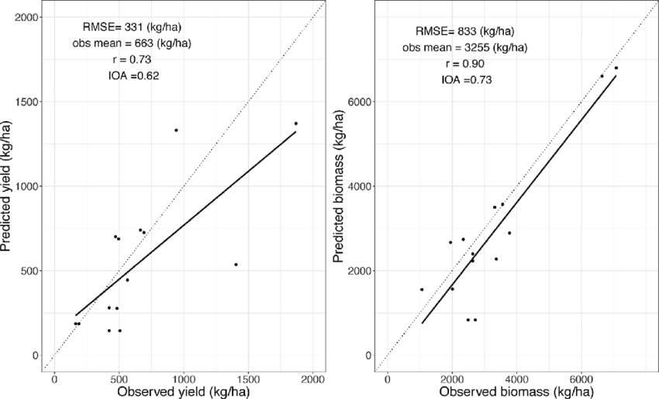
Third Step: Modeling
Model Evaluation
Model Evaluation

Slide 26
Third Step: Modeling
Model Evaluation
This is where mathematics and statistics come in (again) .
Evaluation of the model needs to choose method of evaluating the model. Even choosing the right model to calculate error made the difference of choosing the “best” solution.
Ask for feedback from fellow data scientist or data lead to gain fresh insight on the model. This can help to minimize expertise bias.

Slide 27
Third Step: Modeling
Who are you working with?
Product Engineer
Product Manager
Data Scientist
Data Lead
Minimum level of understanding
Data Analyst: Basic
Data Scientist: Mastery

Slide 28
Fourth Step: Deployment
Business Understanding
Deployment
Data Understanding & Processing
Modeling

Slide 29
Fourth Step: Deployment
Deploy the Model
Deploy the Model

Slide 30
Fourth Step: Deployment
Deploy the Model
This is the moment that send shiver down your spine.
Deploy the model for production and add system to monitor the status of the model.
Check whether the production result answers the problem
If the production result answers the problem, prepare the model so that you don’t have to babysit the model in production

Slide 31
Fourth Step: Deployment
Feedback
Has the problem been solved?
Feedback

Slide 32
Fourth Step: Deployment
Who are you working with?
Product Engineer
Product Manager
Data Lead
Minimum level of understanding
Data Analyst: Basic
Data Scientist: Mastery

Slide 33
Lifecycle of Data Scientist
Business Understanding
Deployment
Data Understanding & Processing
Modeling

Slide 34
What’s Next?

Slide 35
What’s Next
Read paper or books.
Improve the model.
Prepare for the next problem.

